Slide 1
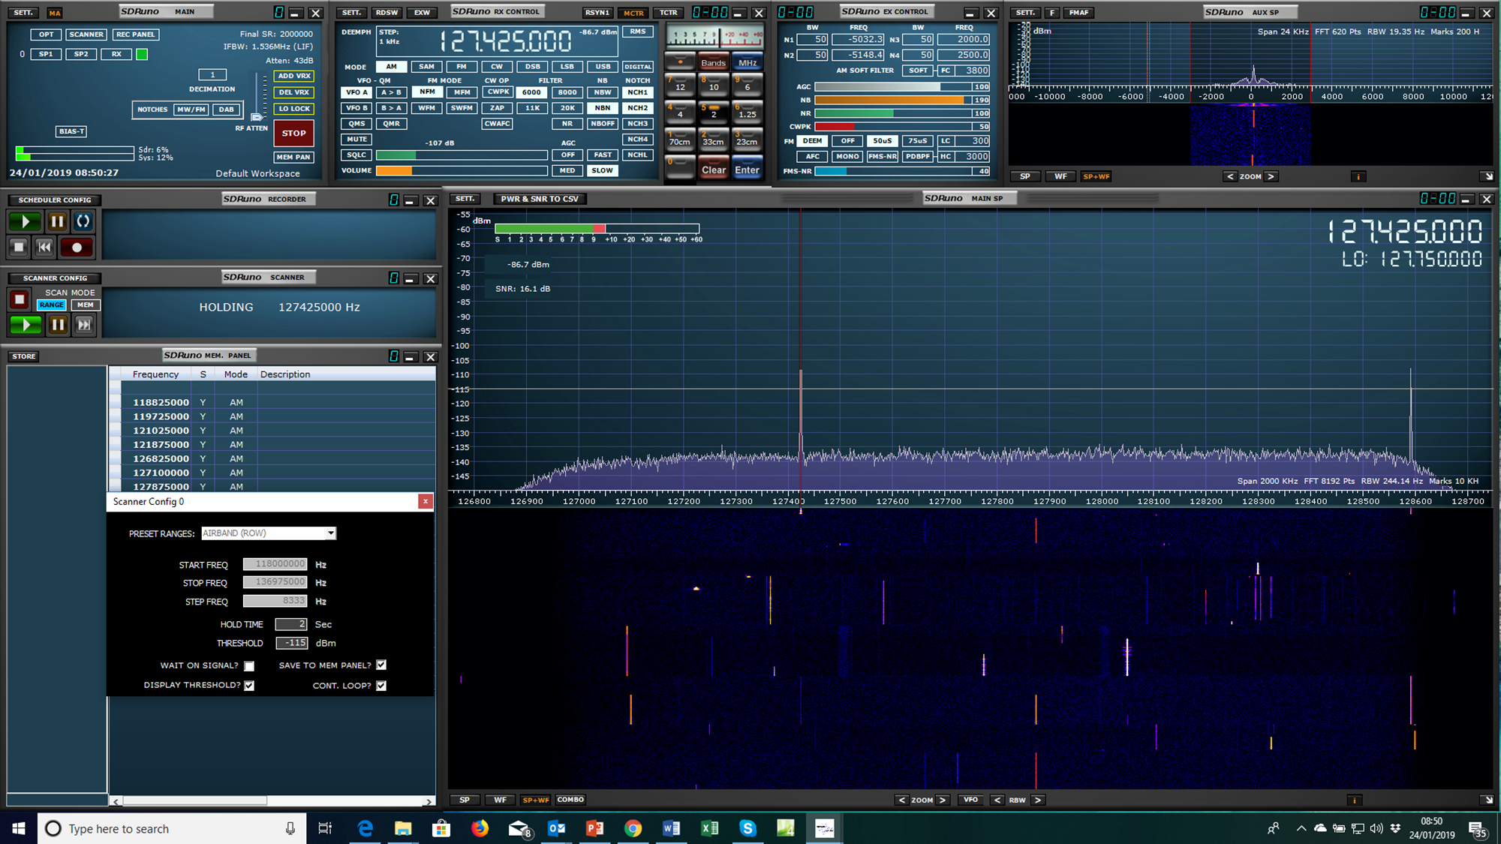
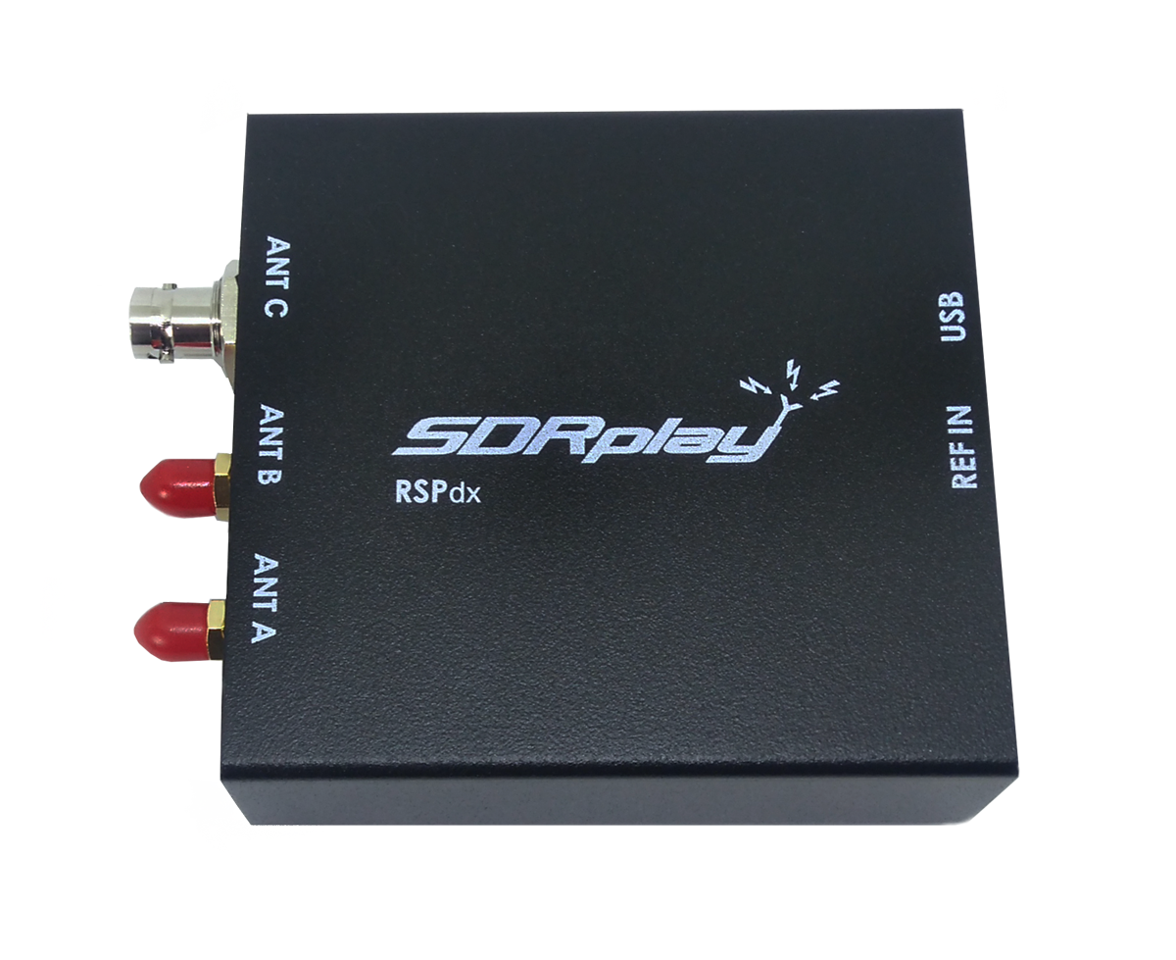
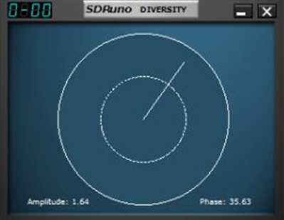

RSPdx with multiple antenna inputs
Diversity tuning with RSPduo
Integrated scanning software
SDRplay SDR Receivers
Continuous SDR coverage from 1kHz to 2GHz (NO GAPS!) – just add a computer & antenna
Receive, monitor and record up to 10MHz spectrum – visualise signals in multiple bands
Use as a stand-alone general coverage RX, or as a panadapter
SDRuno Windows SDR software provided free-of-charge includes a fully integrated scanner
RSPdx has multiple antenna ports and extra features for demanding MF/LF/VLF conditions below 2MHz
RSPduo has two tuners for widely-spaced multiband monitoring & mix and match applications
RSPduo offers diversity tuning for signal enhancement & noise cancellation
Downloadable SD Card image and installer scripts for use with Raspberry Pi3 & 4
Backed by a large and growing SDR receiver user community
www.SDRplay.com

Slide 2

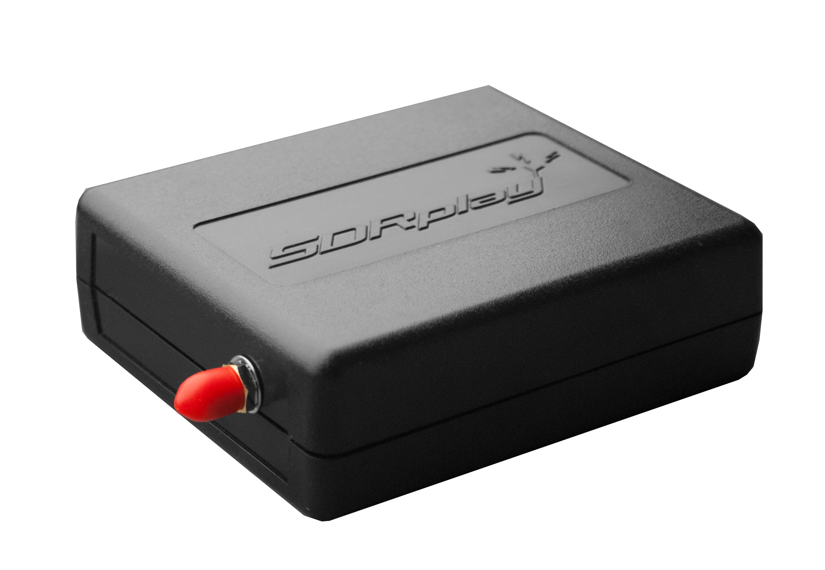
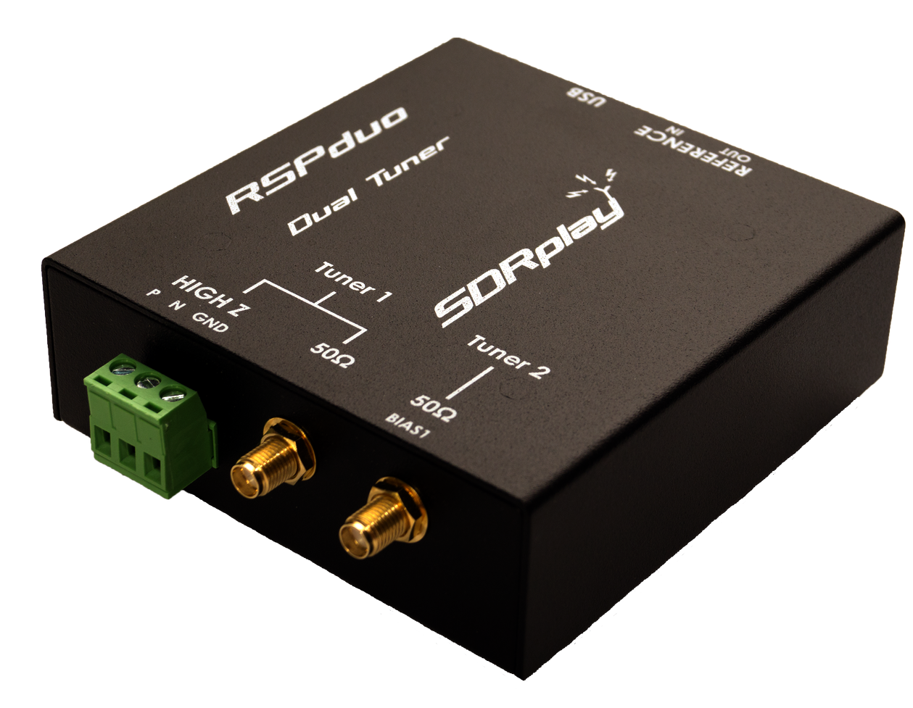
Radio Spectrum Processors
The entry-level SDRplay RSP1A is a powerful wideband full featured 14-bit SDR which covers the RF spectrum from 1kHz to 2GHz. All it needs is a computer and an antenna to provide excellent communications receiver functionality. Combined with the power of ever-evolving SDRuno windows software, you can monitor up to 10MHz of spectrum at a time and optimise reception for the signals you want. A documented API allows developers to create new demodulators or applications around the platform.
RSP1A
The RSPdx
Housed in a strong steel case, in addition to the functionality of the RSP1A, the RSPdx provides three software selectable antenna inputs and an external clock input. It offers substantially enhanced HF performance, using SDRuno’s “HDR mode” optimised for the demanding radio reception conditions below 2MHz. An additional 500kHz low pass filter is also included for LF/VLF enthusiasts.
The SDRplay RSPduo is a complete dual-tuner SDR receiver. Like the other models, it’s a wideband full featured 14-bit SDR which covers the RF spectrum from 1kHz to 2GHz giving 10MHz of spectrum visibility. Alternatively, it can simultaneously monitor two completely separate 2MHz bands of spectrum anywhere between 1kHz and 2GHz. With SDRuno software, the RSPduo can provide diversity tuning which enables both signal enhancement and noise cancellation. The RSPduo also provides three software selectable antenna inputs, one of which is a high impedance input for direct connection to a long wire antenna
RSPduo
When used with SDRplay’s own SDRuno software, the RSP becomes a high performance general coverage receiver or spectrum monitoring instrument for the lab. A stand-alone spectrum analyser software package is also available
www.SDRplay.com
Jan 2021

